Slide 1
Programming Fundamentals Lecture #9 Functions
Junaid Hassan
Lecturer CS & IT Department UOS MBDIN
junaidte14@gmail.com

Slide 2
Recursion
A recursive function is a function that calls itself either directly or indirectly through another function
Recursive problem-solving approaches have a number of elements in common.
A recursive function is called to solve a problem.
The function actually knows how to solve only the simplest case(s), or so-called base case(s)

Slide 3
Recursion
If the function is called with a more complex problem, the function divides the problem into two conceptual pieces: a piece that the function knows how to do and a piece that it does not know how to do.
To make recursion feasible, the latter piece must resemble the original problem, but be a slightly simpler or slightly smaller version.
Because this new problem looks like the original problem, the function launches (calls) a fresh copy of itself to go to work on the smaller problem—this is referred to as a recursive call and is also called the recursion step
In order for the recursion to terminate, each time the function calls itself with a slightly simpler version of the original problem, this sequence of smaller problems must eventually converge on the base case

Slide 4
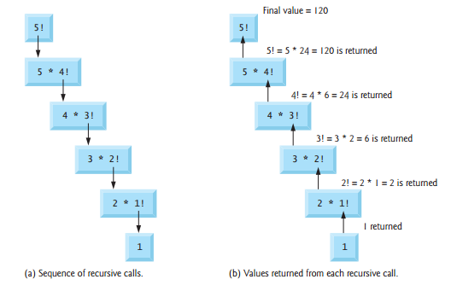
Recursion (Factorial Example)

Slide 5
Fibonacci Series (Recursion Example)
The Fibonacci series
0, 1, 1, 2, 3, 5, 8, 13, 21, …
The Fibonacci series begins with 0 and 1 and has the property that each subsequent Fibonacci number is the sum of the previous two Fibonacci numbers.
The Fibonacci series may be defined recursively as follows:
fibonacci(0) = 0 fibonacci(1) = 1 fibonacci(n) = fibonacci(n – 1) + fibonacci(n – 2)

Slide 6
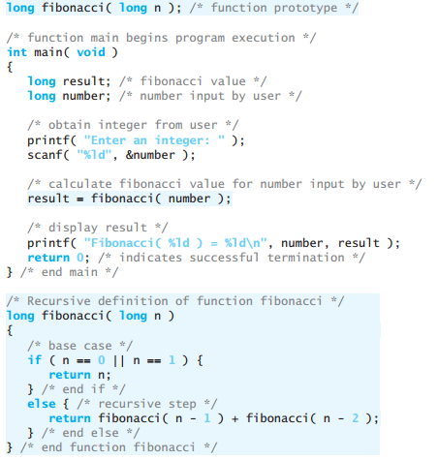
Fibonacci Series (Recursion Example)

Slide 7
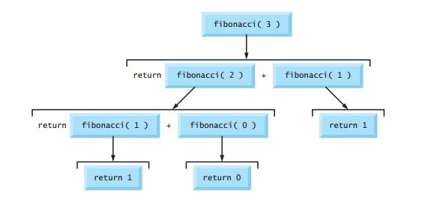
Fibonacci Series (Recursion Example)

Slide 8
Recursion vs Iteration
Both iteration and recursion are based on a control structure: Iteration uses a repetition structure; recursion uses a selection structure.
Both iteration and recursion involve repetition: Iteration explicitly uses a repetition structure; recursion achieves repetition through repeated function calls
Iteration and recursion each involve a termination test: Iteration terminates when the loop-continuation condition fails; recursion terminates when a base case is recognized.
Iteration keeps modifying a counter until the counter assumes a value that makes the loop-continuation condition fail; recursion keeps producing simpler versions of the original problem until the base case is reached

Slide 9
Recursion vs Iteration
Recursion has many negatives.
It repeatedly invokes the mechanism, and consequently the overhead, of function calls.
This can be expensive in both processor time and memory space.
Each recursive call causes another copy of the function (actually only the function’s variables) to be created; this can consume considerable memory

Slide 10
Recursion vs Iteration
Iteration normally occurs within a function, so the overhead of repeated function calls and extra memory assignment is omitted. So why choose recursion?
Any problem that can be solved recursively can also be solved iteratively (nonrecursively).
A recursive approach is normally chosen in preference to an iterative approach when the recursive approach more naturally mirrors the problem and results in a program that is easier to understand and debug.
Another reason to choose a recursive solution is that an iterative solution may not be apparent

Slide 11
References
Textbook ch#5

